Slide 1


Food Image Classification
Akul Arun (S10243523)
(S10243523)
Notes:
I am Akul and today I will be presenting on food image classification.

Slide 2
Table of Contents
01
04
Problem Understanding
Scratch Model
02
05
Baseline Model
Pre-train Model
03
06
Data Preprocessing
Model Comparison
Notes:
These are the contents I will be sharing today.

Slide 3
Problem Understanding
Aim
Build Models to Recognise and Classify 10 types of Food
Problem Type
Multi Class Classification
Notes:
I want to predict if the driver would win a podium in the next race so this is a classification problem as the driver would either get the podium or not.

Slide 4
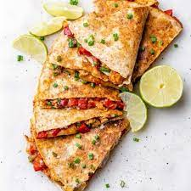

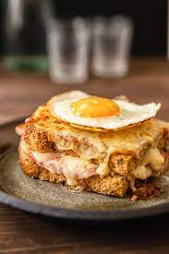


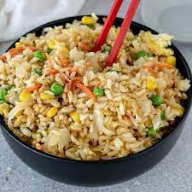
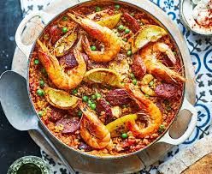
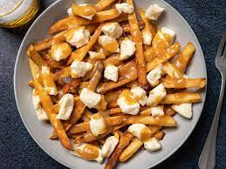
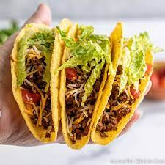
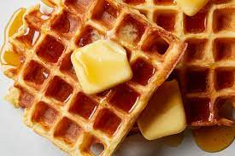
Food Classes
Chicken Quesadilla
Crème Brulee
Croque Madame
Foie Gras
Fish And Chips
Fried Rice
Paella
Poutine
Tacos
Waffles

Slide 5
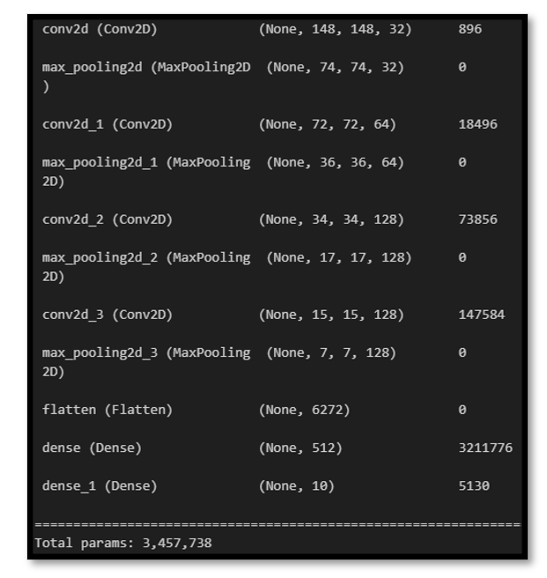
Baseline Model
Test
Test Data Preprocessing
Reference
Evaluate Performance of More Complex Models
Baseline Architecture
Notes:
First, I started with data cleaning in the races table and noticed that there were some incorrect year values that had 5 digits.

Slide 6
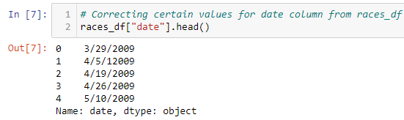
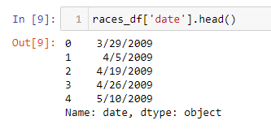
Correction of date (races_df)
Remove 1
Notes:
First, I started with data cleaning in the races table and noticed that there were some incorrect year values that had 5 digits.

Slide 7
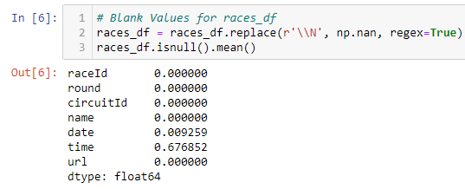
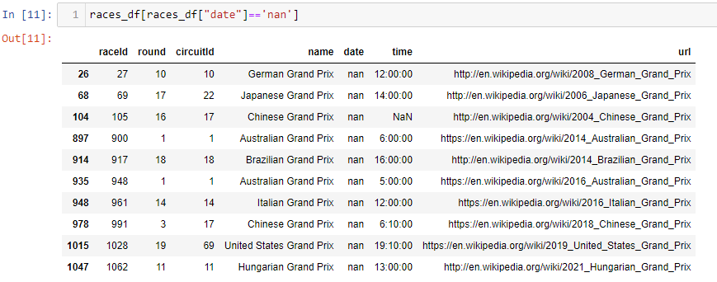
Filling in Missing Values for date (races_df)
Notes:
I noticed that there were 10 missing values in the date column.

Slide 8
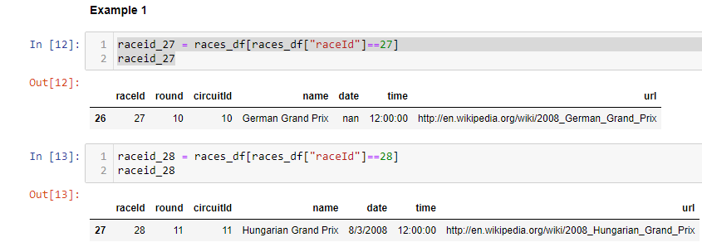

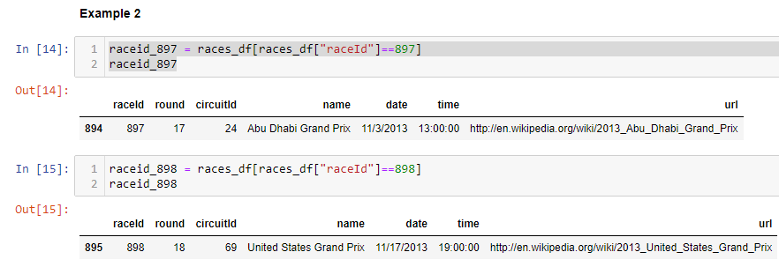
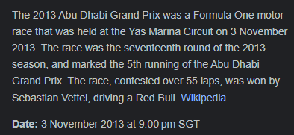
Pattern for Date Missing Values (races_df)
Next Race happened after 14 days of German Grand Prix
Next Race happened after 14 days of Abu Dhabi Grand Prix
Notes:
Upon inspecting the null values, I noticed they followed the same pattern with the race date after them. The next race date happened after 14 days of the null race dates. I also confirmed this through online research.

Slide 9
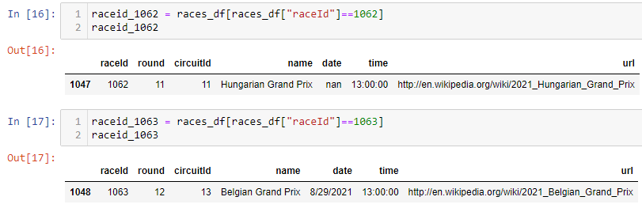
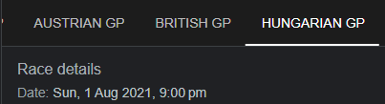
Outlier of Pattern (races_df)
Next Race happened after 28 days of Hungarian Grand Prix
Notes:
After checking the validity of the pattern for all 10 null values, I noticed that one of the null values did not follow this pattern. In this case, the next race happened after 28 days. This might be due to f1 break times.

Slide 10
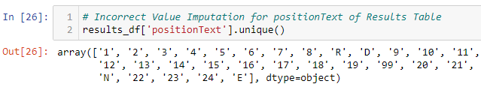
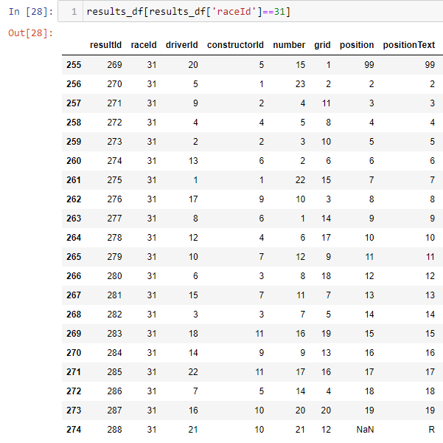
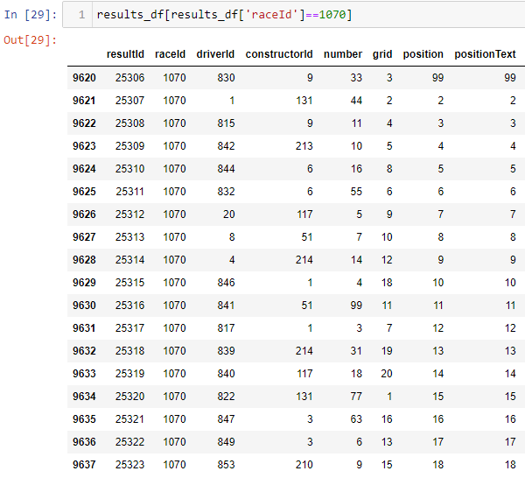
Correction of positionText (results_df)
99 should be 1
Notes:
When I saw that there was a category for 99 in positionText, I got suspicious as there has never been 99 racers in Formula 1. I identified another pattern while correcting positionText. As seen from the 2 examples, There are 99 values at the places where 1 should be so I replaced them.

Slide 11
Wrangling on Multiple Tables
Changing Data Types of Features
Feature Extraction & Creation
Subsetting, Grouping & Merging Tables
Notes:
Now, I will be moving on to data wrangling.

Slide 12

Extraction and Creation of features
Extraction of Features
Creation of Features
Year from date (races_df)
Month from date (races_df)
Day from date (races_df)
Seasons from month (races_df)
Driver age_at_race using dob from drivers_df and date from races_df (Mathematical Calculation)
Driver names by concatenating forename and surname from drivers_df
Driver_error_dnf using statusId from results_df and refering to the status table (DNF due to driver error)
Constructor_error_dnf using statusId from results_df and refering to the status table (DNF due to car problem)
Notes:
I mainly extracted features time series data from date and for creation of features, I applied maths and made use of information from other features.

Slide 13
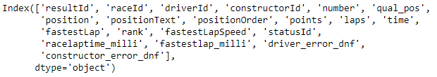
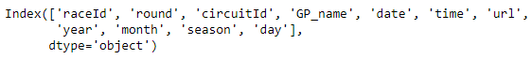
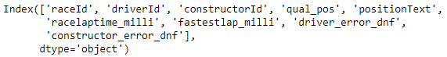
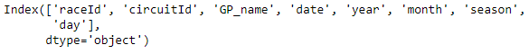
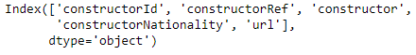
Subsetting
results_df
01
races_df
02
drivers_df
03
constructors_df
04
Circuits_df
05
Notes:
For subsetting, I dropped columns that I thought were unnecessary for my prediction problem.

Slide 14

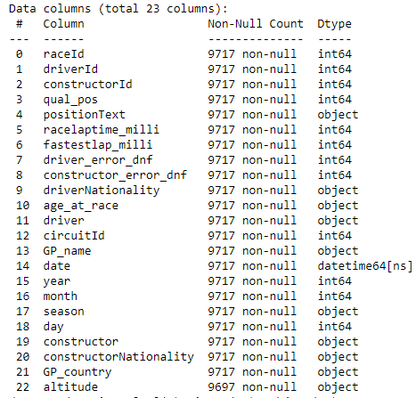
Merging of Tables
Merged_df
Df1 = Results_df + Races_df
01
Inner Join on RaceId
Df2 = df1 + drivers_df
02
Inner Join on driverId
Df3 = df2 + constructors_df
03
Inner Join on constructorId
Df4 = df3 + circuit_df
04
Inner Join on circuitId
05
Merged_df = df4
Notes:
I merged all the tables based on their primary and foreign keys and I dropped the keys after merging them.

Slide 15

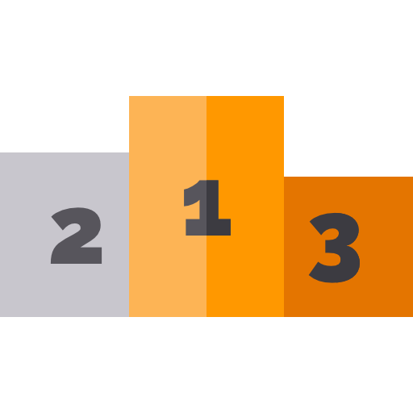
Creation of Target feature & Additional Features
Target Feature
Creation of Features
Has Binary Values (1 for podium finish, 0 for no podium finish)
Driver_finish_percent (Grouping for past data)
Constructor_finish_percent (Grouping for past data)
Driver_podium_percent (Grouping for past data)
constructor_podium_percent (Grouping for past data)
Driver_home - Check if race is happening where driver is born
Constructor_home - Check if race is happening where company was started
Notes:
After merging, I created my target feature called podium which was made using positionText. The podium feature has binary values and would have the value 1 for podium finish and 0 otherwise. I also created a few more features using grouping to obtain the past data.

Slide 16
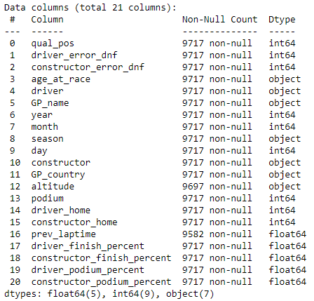
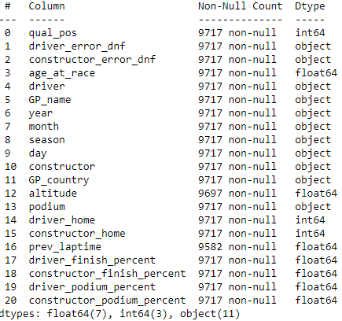
Data Type Correction
Before
After
Vs
Used for Train-Test Split
Notes:
After that I changed the datatype as the binary features were in integer but I wanted them in object datatype.

Slide 17
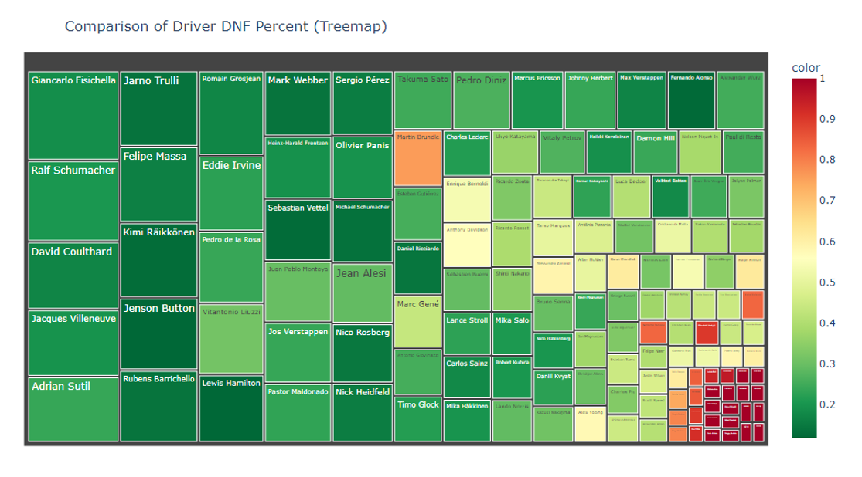
Data Exploration
Notes:
This shows the relationship between the numerical variables. The features that have the highest correlations are constructor_podium_finish and constructor_finish_percent.

Slide 18
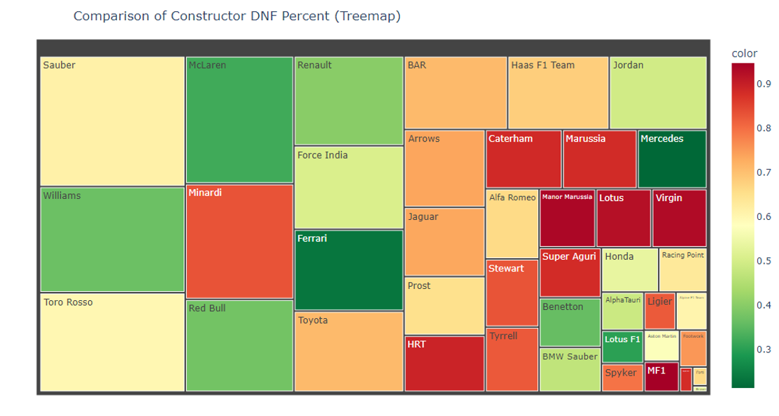
Notes:
This shows the relationship between the numerical variables. The features that have the highest correlations are constructor_podium_finish and constructor_finish_percent.

Slide 19

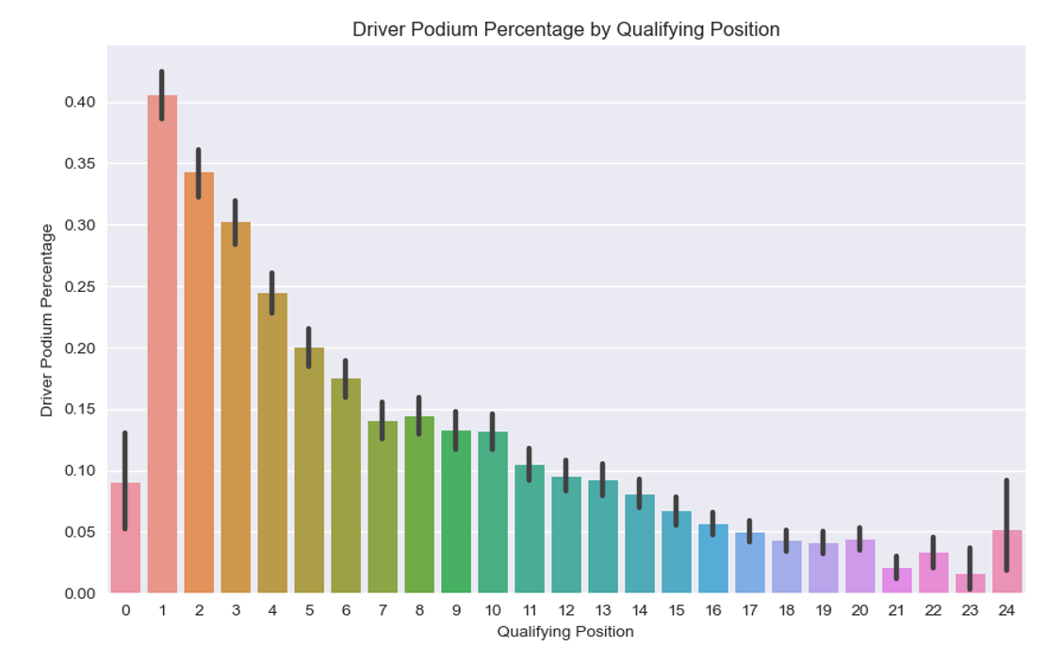
Notes:
This shows the relationship between the numerical variables. The features that have the highest correlations are constructor_podium_finish and constructor_finish_percent.

Slide 20
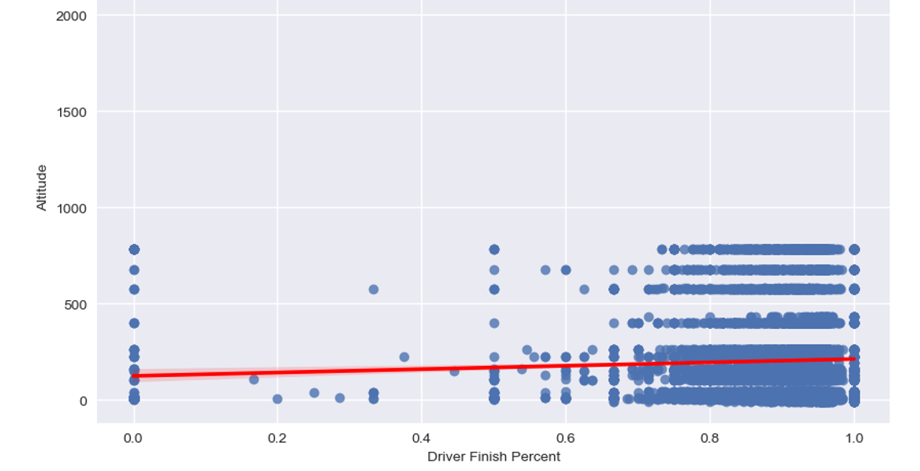
Notes:
This shows the relationship between the numerical variables. The features that have the highest correlations are constructor_podium_finish and constructor_finish_percent.

Slide 21
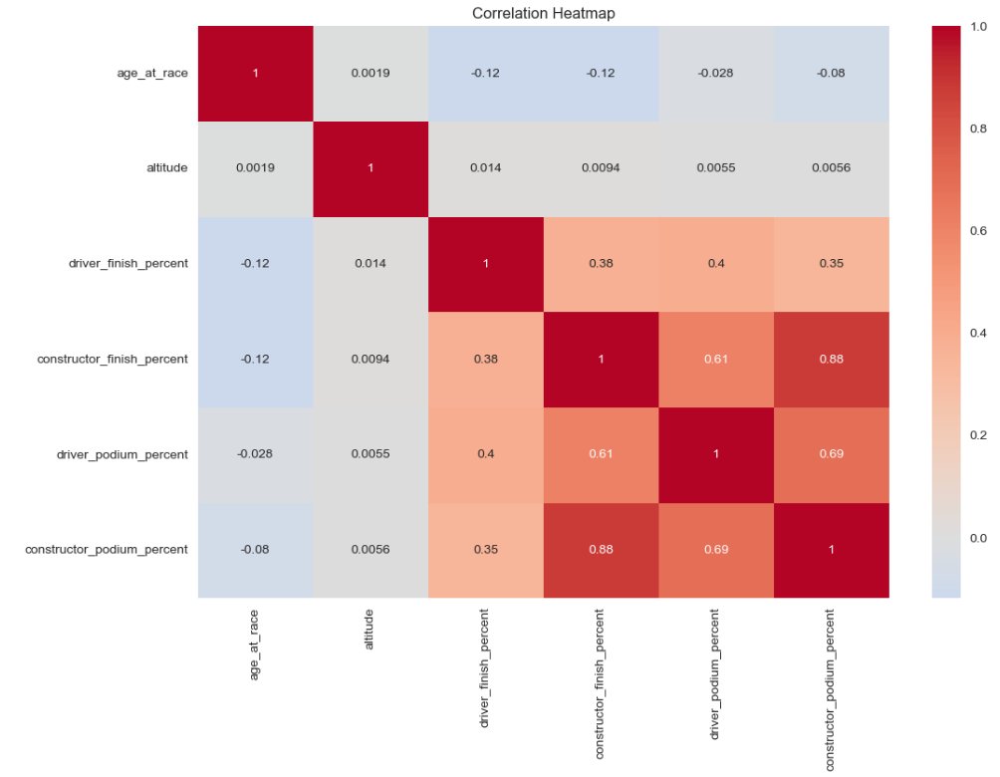
Correlation Heatmap
Notes:
This shows the relationship between the numerical variables. The features that have the highest correlations are constructor_podium_finish and constructor_finish_percent.

Slide 22
Data Transformation
Missing Value Imputation using Pipelines
Categorical Data Transformation
01
02
One-Hot Encoding
Mean Imputation
Numerical Data Transformation
03
04
Dealing with Outliers
Yeo-Johnson Transformation
Capping
Binning
05
Equal-Frequency Discretization
Notes:
Now, I will move on to data transformation.

Slide 23
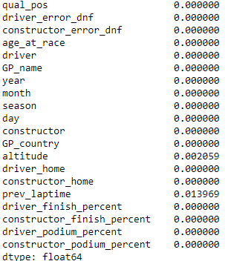
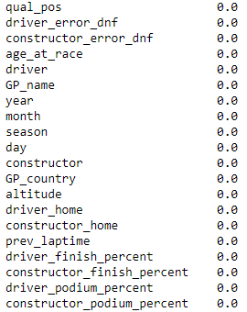
Missing Value Imputation
Before
After
Mean Imputation
Notes:
I had missing values for altitude so I used mean imputation to fill them.

Slide 24
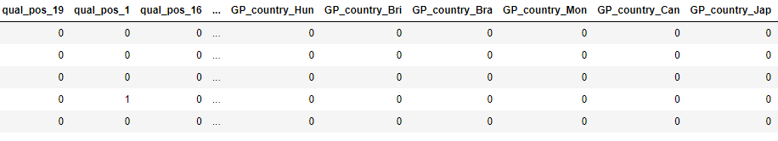
Categorical Variable Transformation
Theory
One-Hot Encoding
One-hot encoding represents each category of a categorical variable with a binary variable.
Greatly increases dimensionality
Performed on frequent categories only
Output data
Notes:
Then I using label encoding to transform categorical variables.

Slide 25
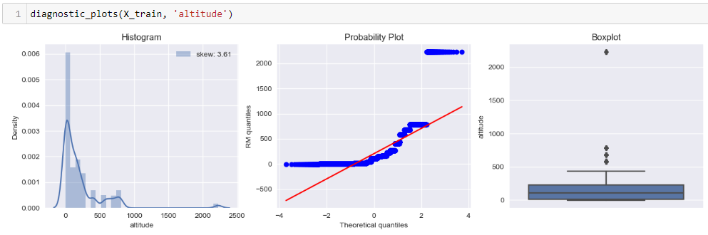
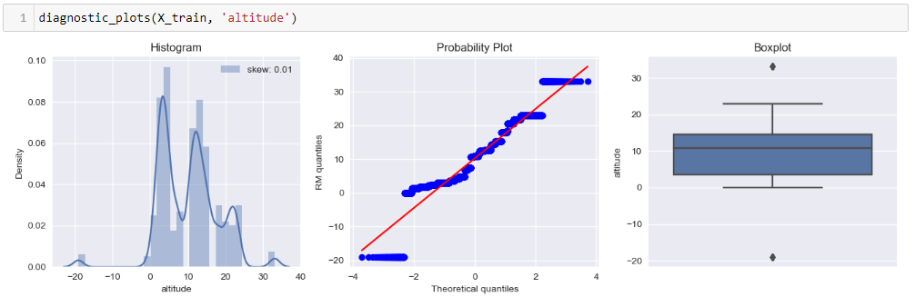
Transforming altitude
01
02
Yeo-Johnson Transformation
Altitude (Before)
Altitude (After)
Notes:
After transforming altitude with yeo-johnson, the distribution has become less skewed and there are fewer outliers.

Slide 26
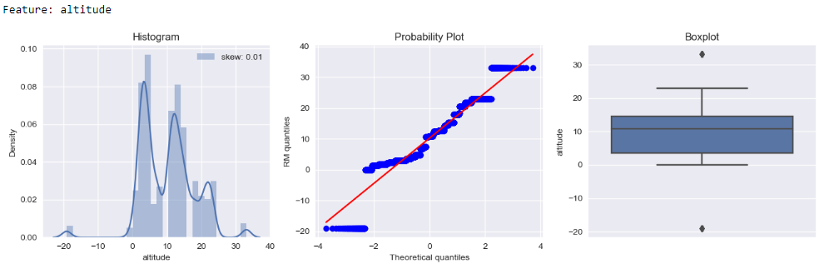
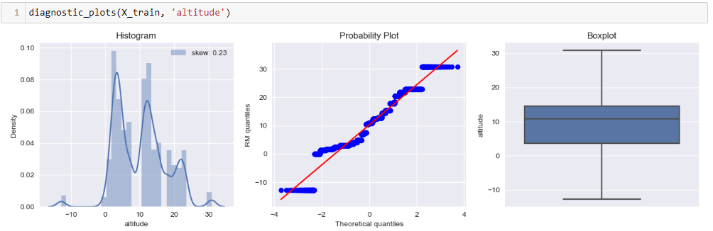
Dealing with Outliers
Before
After
Capping
Notes:
After all numerical transformation, there were only outliers for altitude and I handled them by using capping.

Slide 27
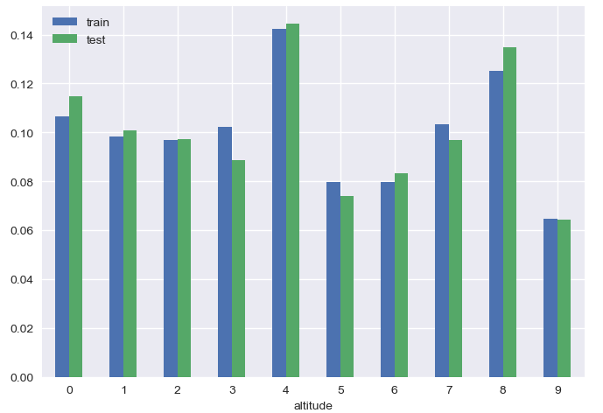
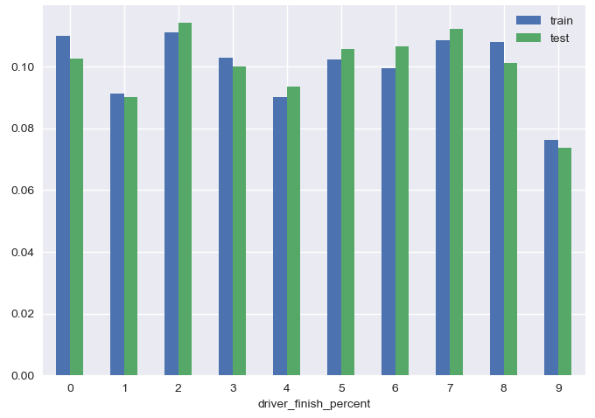
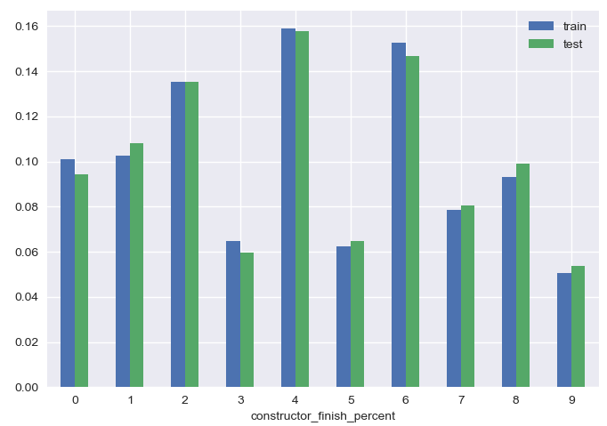
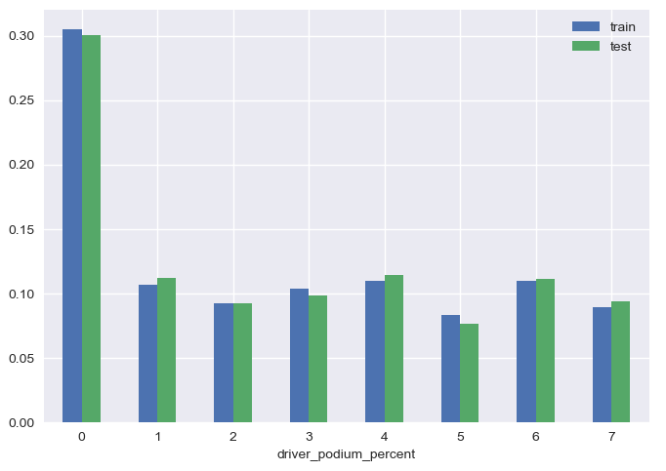
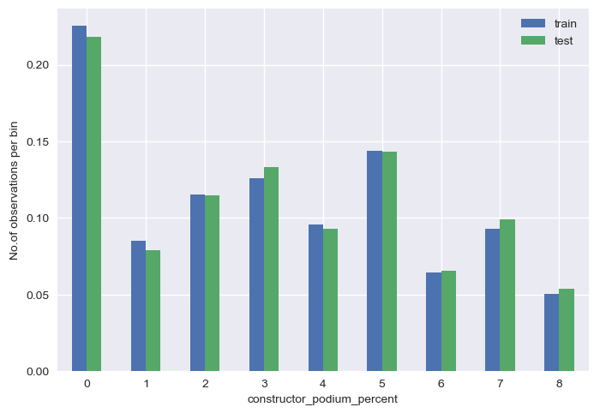
Binning
Equal-Frequency Discretization
altitude
Driver_finish_percent
constructor_finish_percent
Driver_podium_percent
Constructor_podium_percent
Notes:
For binning I used Equal-frequency Discretization which divides the values into intervals that carry the same proportion of observations by dividing the continuous variable into quantiles.

Slide 28
Feature Engineering
Feature Engineering Done in this Project
Scaling
Adding new features
Compare feature importance
Algorithms converge faster
Improved model performance
ML models sensitive to scale
Bigger scale features dominate over smaller scale features
Provide the model with more information
Introduce more relationships
Decrease the noise of data
Increase accuracy
Polynomial Expansion
Notes:
Feature engineering can improve the accuracy of models. As part of feature engineering, I did scaling and added new features using polynomial expansion.

Slide 29
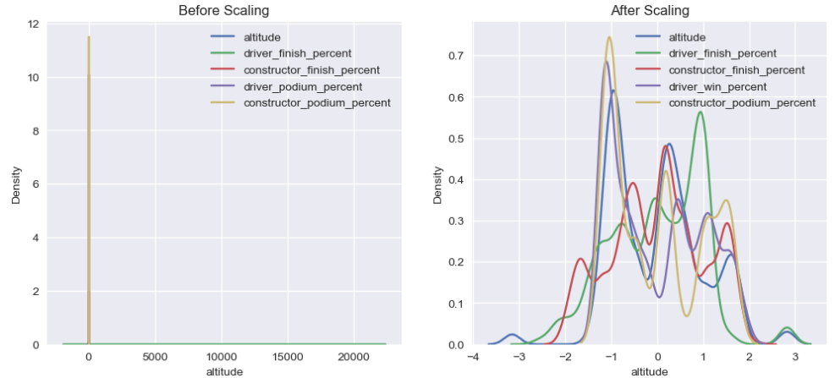
Scaling
Before Scaling
Standardisation
After Scaling
Notes:
Standardization is the process of centering the variable at zero and standardizing the variance to 1. After scaling, the scale has reduced in size significantly and we can see the variables are sharing the same scale.

Slide 30
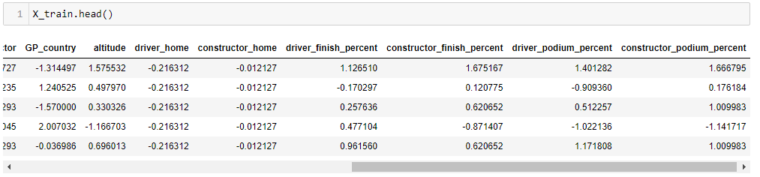
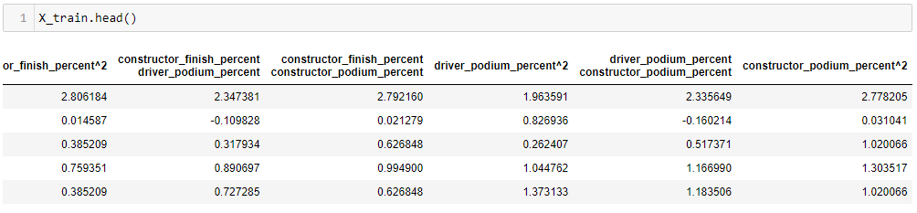
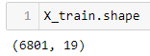

Polynomial Expansion
Degree = 2
Before Expansion
After Expansion
Notes:
After expansion, the accuracy on train data increased while the accuracy on test data decreased. This is not desirable as this shows overfitting so it is not a good idea to conduct polynomial expansion.

Slide 31

Model Performance
Naïve Baseline
Logistic Regression
Notes:
My naïve baseline model had a score of around 85% while my actual model which is a logistic regression model, had a score of around 89%.

Slide 32




Feature Importance
Notes:
These are the top 10 and bottom 10 feature importance. I did not expect constructor_error_dnf to have the highest importance.

Slide 33
Thank You

